Slide 1

Filing Your Property Appeal
A Guide to the IMSLake.org Property Search Portal and SmartFile E-Filing Portal

Slide 2
Ensuring Integrity and Transparency in Assessments
Welcome to IMSLake.org, a new property assessment information website. We hope to provide you with an easy to use resource for reviewing your property assessment information.
The website contains property assessment information for Cuba, Ela, Grant, Libertyville and Vernon Townships in Lake County, Illinois.
The next few pages provide detailed information on navigating the site to retrieve your property characteristics and to create comparable property grids as evidence for filing appeals based on recent sales or to determine equity.
Note: All documents uploaded on the Board of Review’s SmartFile E-Filing Portal may be available for public view. Please redact personal information including email address and phone number.
1

Slide 3
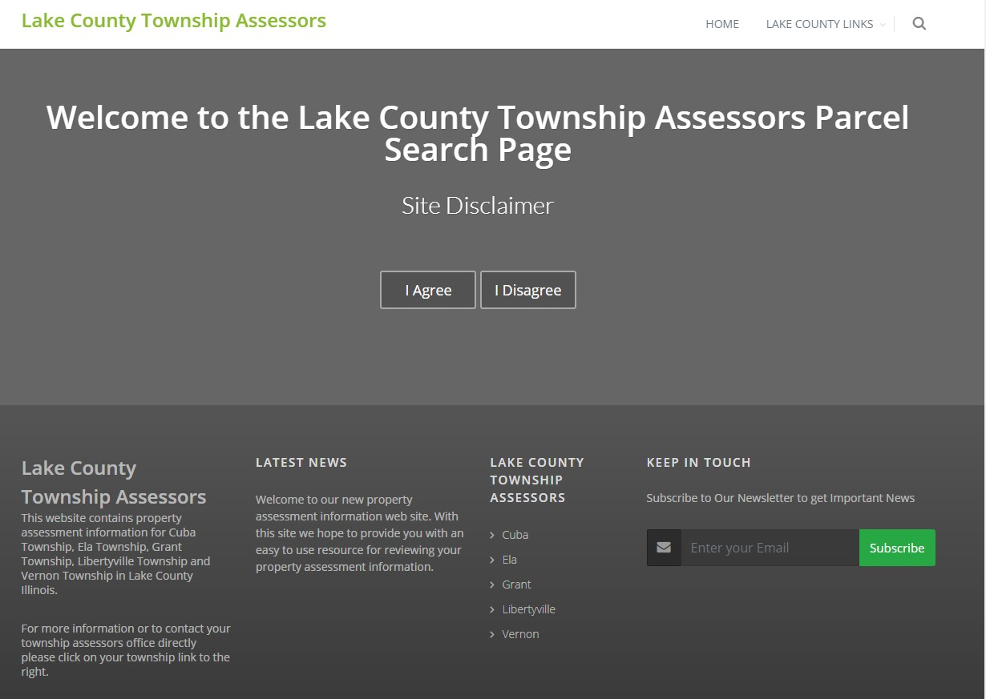
Acknowledge the Site Disclaimer. You may also Sign Up for the E-Newsletter.
2

Slide 4
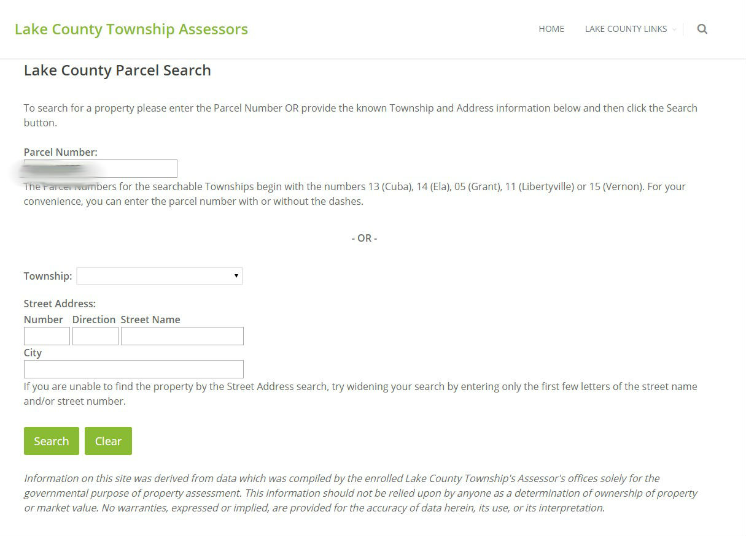
Enter PIN or Address and Click “Search”
3

Slide 5
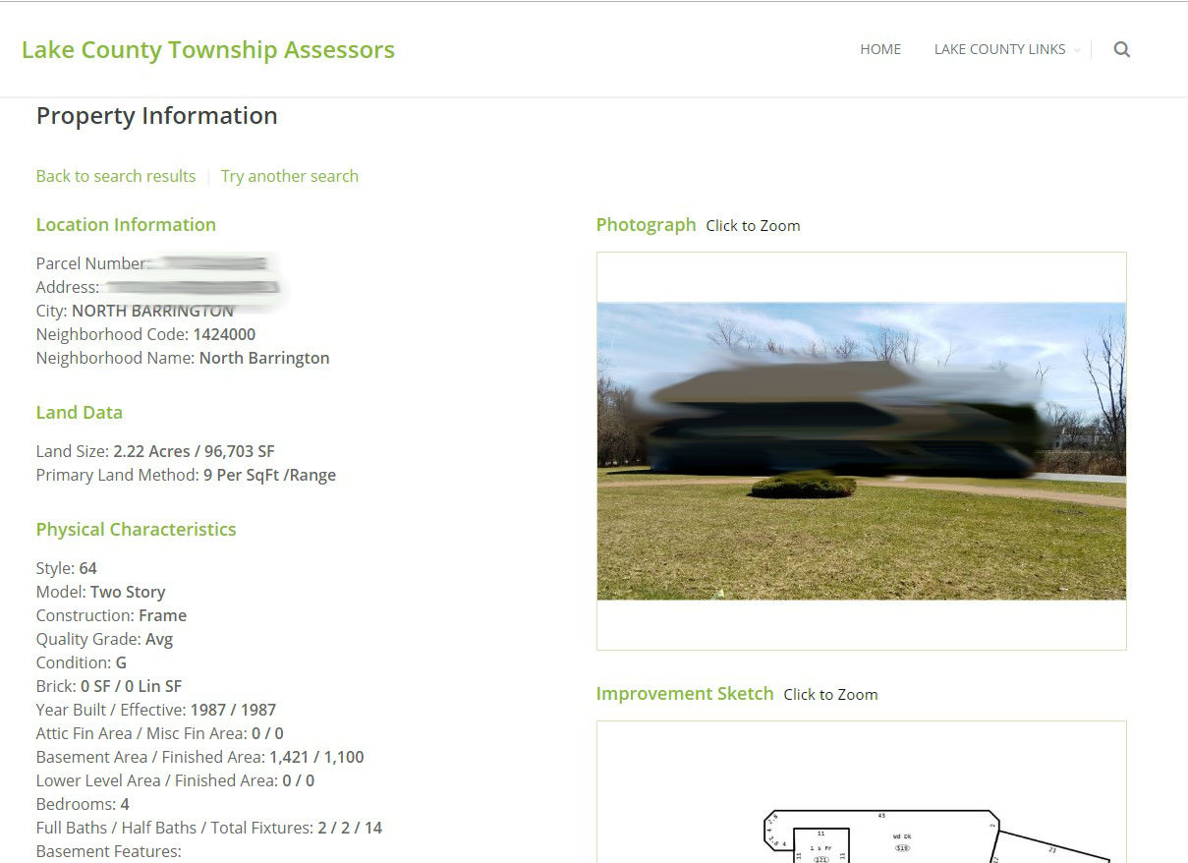
View your Property Information
Closely review this information for accuracy.
Call your local assessor’s office for Factual Errors on physical characteristics of the property.
You can scroll down the page for Assessment Information, Sales Information and to view your tax bill, exemption status and a map of your parcel.
4

Slide 6
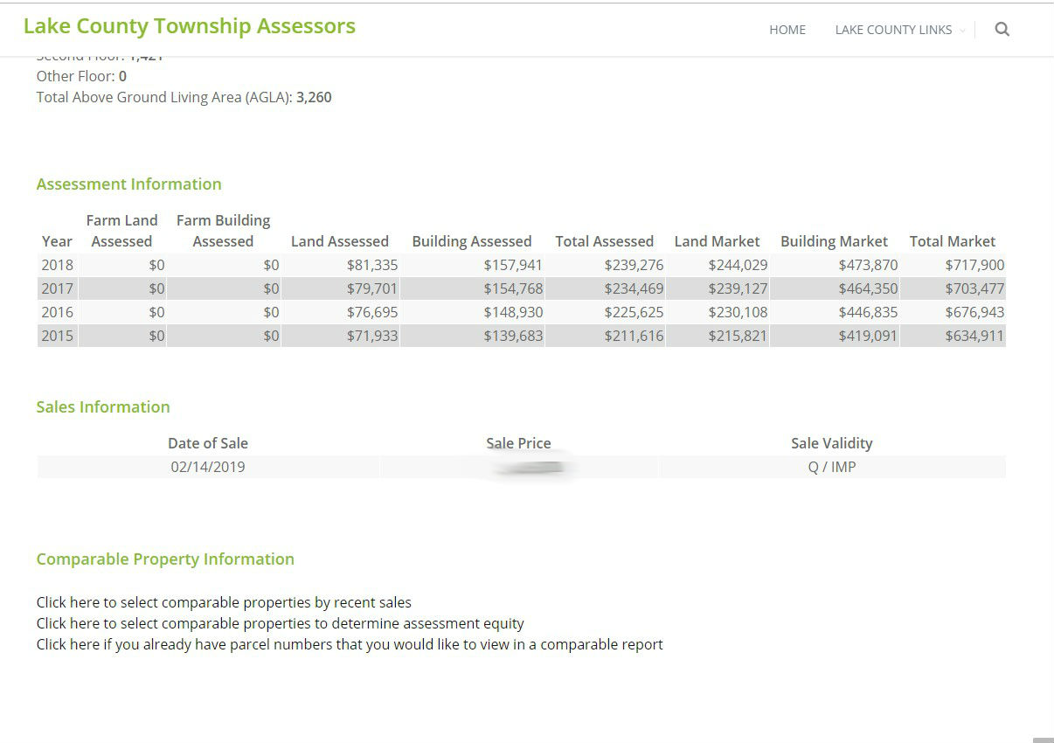
Review Assessment Information
5

Slide 7
Review Sales Information
If your reason for appeal is Recent Purchase of Property, the Sales Information is listed.
The evidence to support your appeal includes your PTAX-203 form, MLS listing or Closed Client Listing Sheet, or other closing documents.
1
6

Slide 8
Review Comparable Property Information
If your reason for appeal is Recent Sales Comparables or Equity of Assessments Comparable, your evidence grid may be created here.
Create a grid according to your appeal. A custom grid is available if you have the parcel numbers (PIN).
7

Slide 9
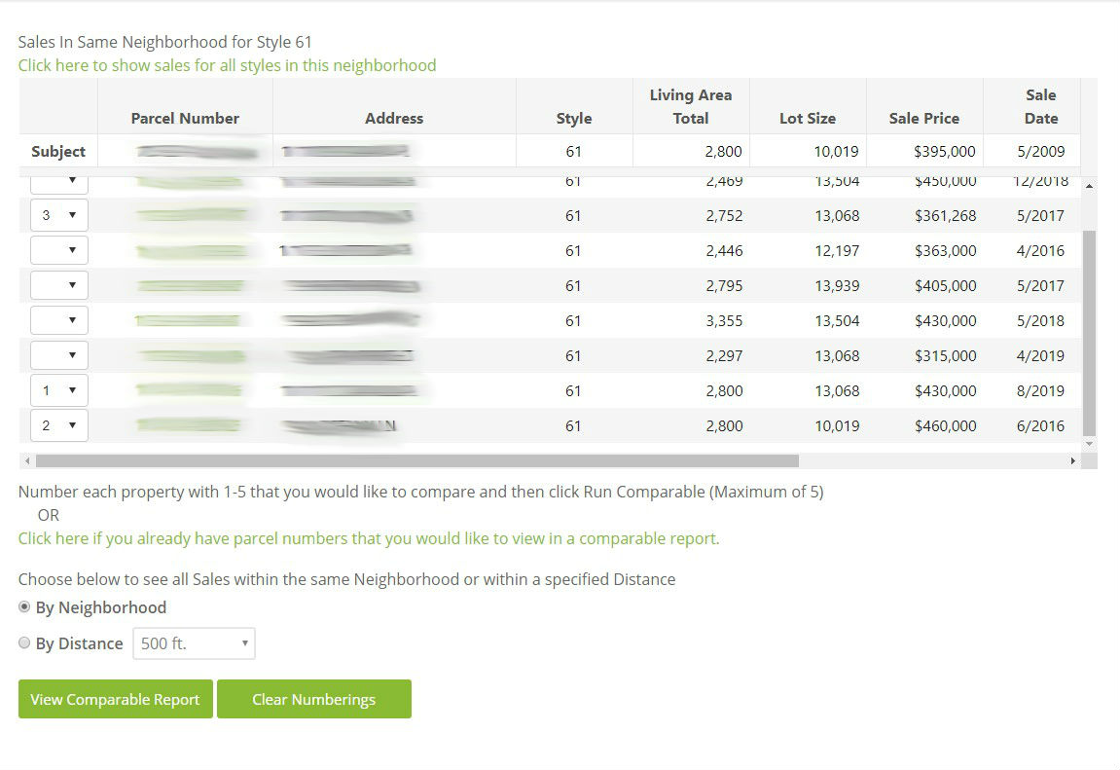
Creating a Grid For Comparable Sales
Click to select comparable properties by recent sales.
An automatically generated grid will appear.
Select the subject properties you want to use for evidence.
You can also add parcel numbers you want to add to the grid or select a specified distance to select comparables.
Click View Comparable Report.
8

Slide 10
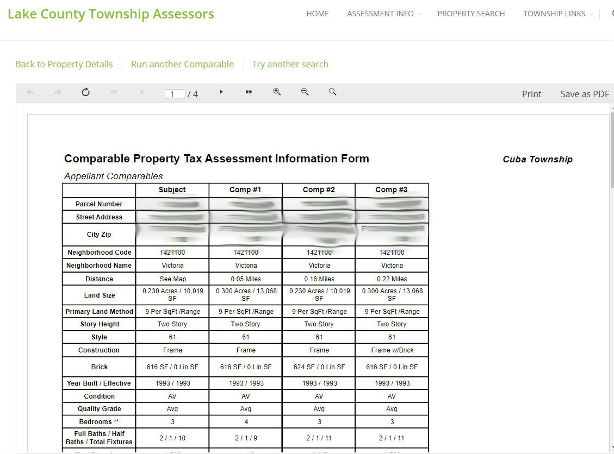
Your Grid is Ready to Print and to Save as Evidence
Your property grid will list property characteristics, an exterior sketch of the residence, and a photo (if available).
You can modify your search or run another comparable report.
If you are filing an appeal based on sales comparables or uniformity, please save your PDF (evidence) to upload when you file your appeal.
9

Slide 11
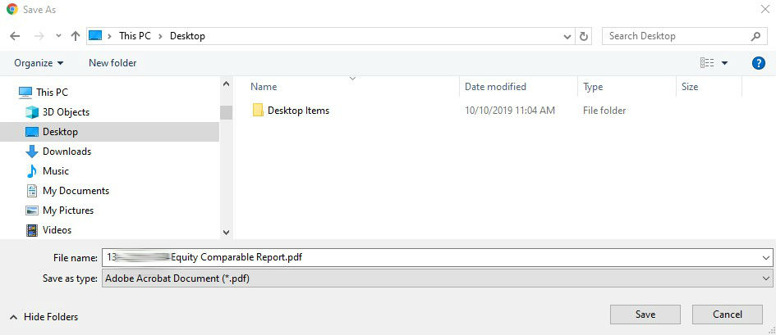
Save Your Grid as Evidence
Click Save as PDF.
The grid is automatically named as the 10-digit PIN and type of grid (Sales or Equity Comparable).
Now you are ready to upload your evidence grid when you file online.
10

Slide 12
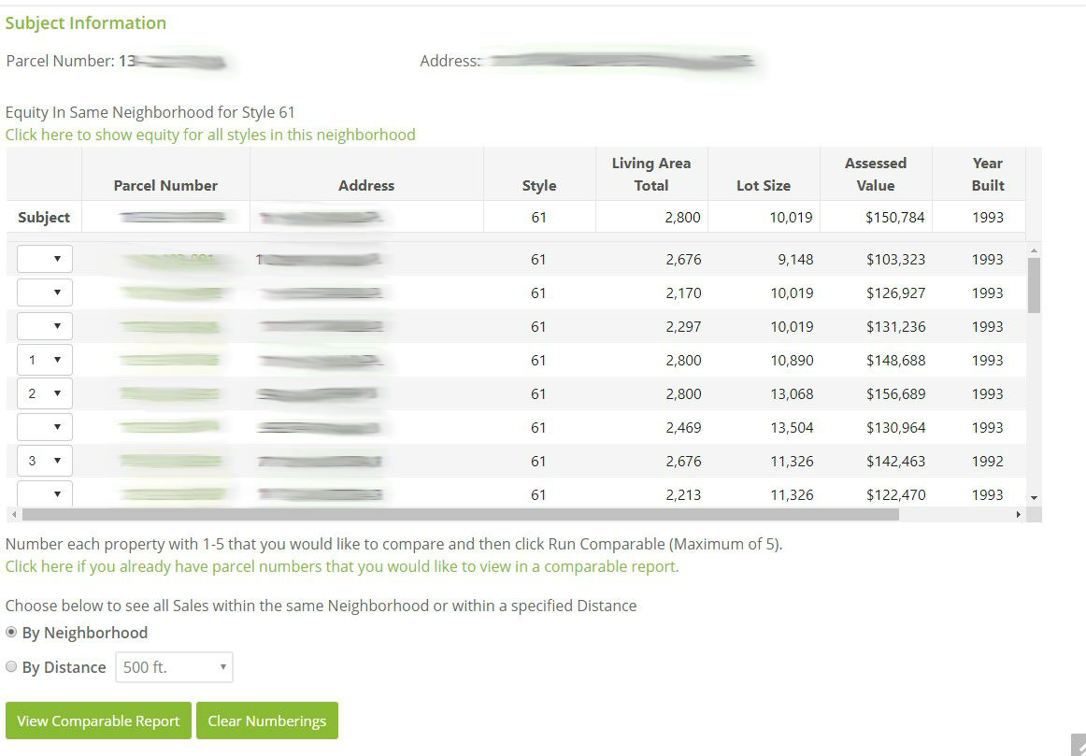
Creating a Grid For Equity of Assessments
Click to select comparable properties by assessment equity.
An automatically generated grid will appear.
Select the subject properties you want to use for evidence.
You can also add parcel numbers you want to add to the grid or select a specified distance to select comparables.
Click View Comparable Report.
11

Slide 13
Your Grid is Ready to Print and to Save as Evidence
Your property grid will list property characteristics, an exterior sketch of the residence, and a photo (if available).
You can modify your search or run another comparable grid.
If you are filing an appeal based on sales comparables or uniformity, please save your PDF (evidence) to upload when you file your appeal.
12

Slide 14
Save Your Grid as Evidence
Click Save as PDF.
The grid is automatically named as the 10-digit PIN and type of grid (Sales or Equity Comparable).
Now you are ready to upload your evidence grid when you file online.
13

Slide 15

Next Step: Determine the Reason for Your Appeal
Factual Error (e.g. incorrect square footage or other property characteristics).
Recent Appraisal – You obtained an appraisal effective January 2023.
Recent Purchase of Property – You purchased the subject property in 2022 or 2023 and the sale price is less than the Assessed Market Value listed on the Assessment Notice.
Recent Sales Comparables – The sales price per AGLA (above grade living area) of recent sales in your neighborhood is less than the market value per AGLA of your subject property.
Equity of Assessments Comparables – The building assessment per AGLA of your subject property is greater than the AGLA of comparable properties in your neighborhood.
Matters of Law.
14

Slide 16
Gather Evidence For Your Appeal Reason
Reason for Appeal | Evidence
Factual Errors | Must include a Property Record Card, statement highlighting incorrect and correct data and requires Assessor access to property. Please contact your Township Assessor’s Office for a Property Record Card.
Recent Appraisal | Provide a 2023 appraisal demonstrating the Market Value is less than the Market Value on your Assessment Notice.
Recent Purchase of Property | PTAX-203 Real Estate Transfer Form, MLS listing or Closed Client Listing Sheet, or other closing documents.
Recent Sales Comparables | Go to the IMSLake.org and select your comparables based on recent sales. Save the IMSLake Grid as evidence to upload on SmartFile.
Equity of Assessments Comparables | Go to the IMSLake.org and select your comparables based on uniformity. Save the IMSLake Grid as evidence to upload on SmartFile.
Matters of Law | Written statement listing your matters of law.
15

Slide 17
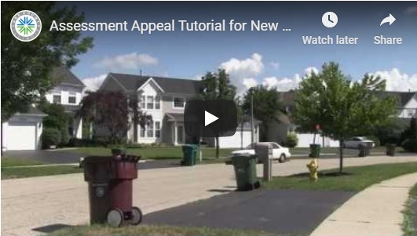
View Lake County’s Assessment Appeal Video
Watch the Tutorial Video.
Gather your evidence and save it in a folder on your computer for easy access when filing online.
16

Slide 18
Read the 2023 Board of Review Rules and Important Filing Date Information
Link to the 2023 Board of Review Rules.
*All Evidence must be submitted at the time of filing except Appraisals. They must be filed within (14) calendar days of the filing deadline for residential and (30) days for industrial and commercial.
**All 2023 Appeals and Evidence may be published on the Lake County Chief County Assessor’s website.
Township | Date of Publication
Cuba | 8/03/2023
Ela | 8/17/2023
Grant | TBD
Libertyville | 8/17/2023
Vernon | 8/10/2023
Township | Final Filing Date
Cuba | 9/05/2023
Ela | 9/18/2023
Grant | TBD
Libertyville | 9/18/2023
Vernon | 9/11/2023
17

Slide 19
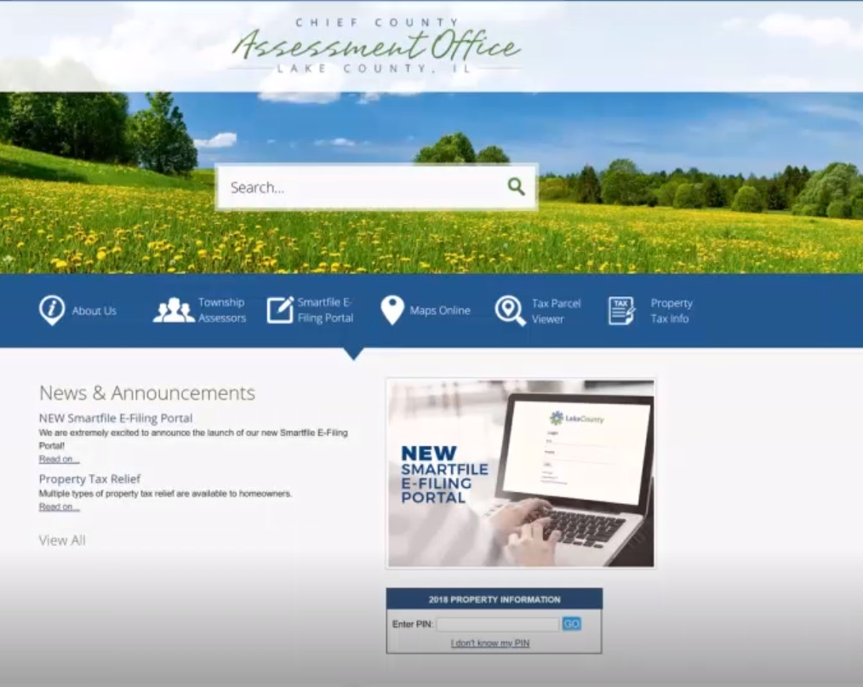
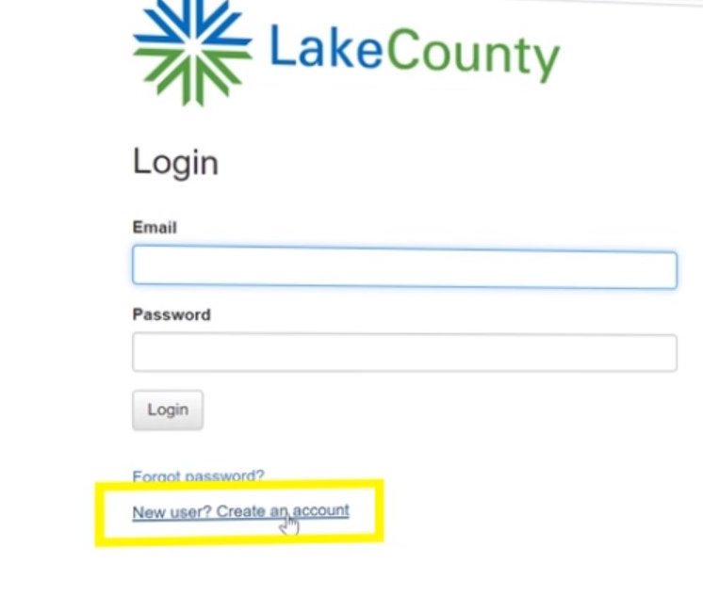
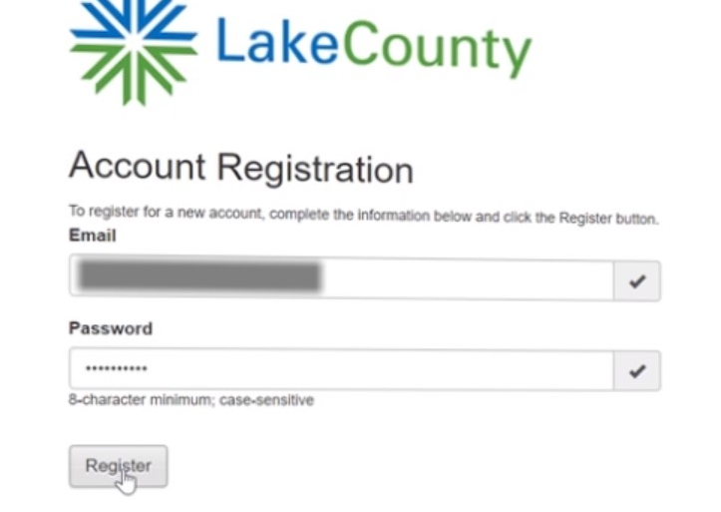
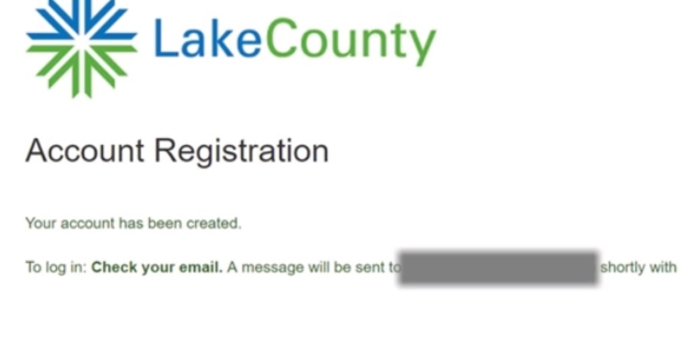
Register to File on Lake County’s SmartFile Portal
1
2
https://lakecountyilpaefile.tylertech.com/lake_il_sf
3
4

Slide 20
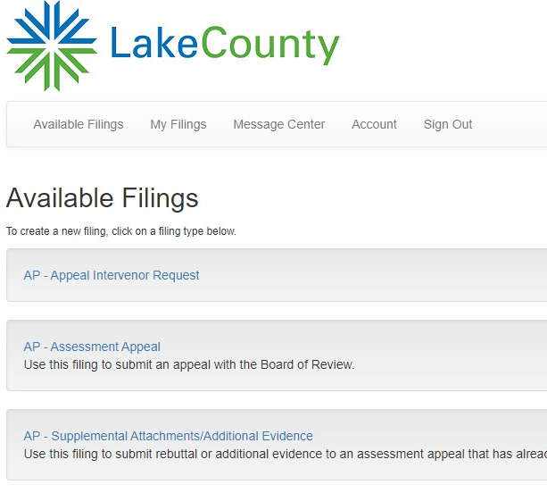
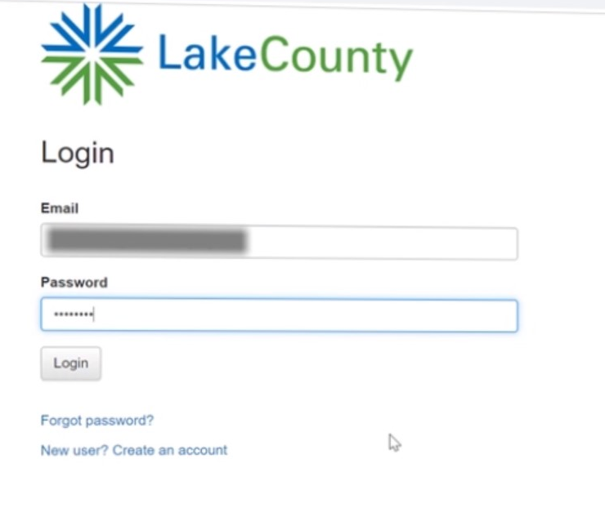
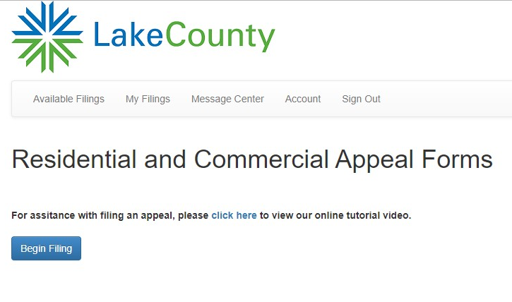
Begin Filing Your Appeal
Enter email and password
Select Assessment Appeal
Click Begin Filing Tab
19

Slide 21
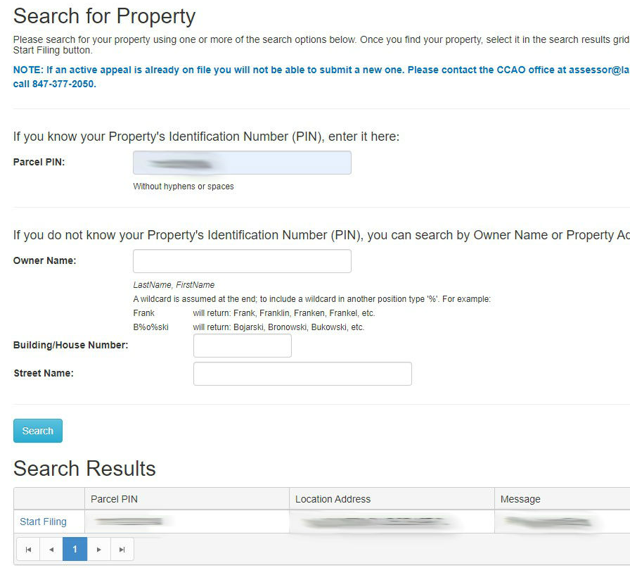
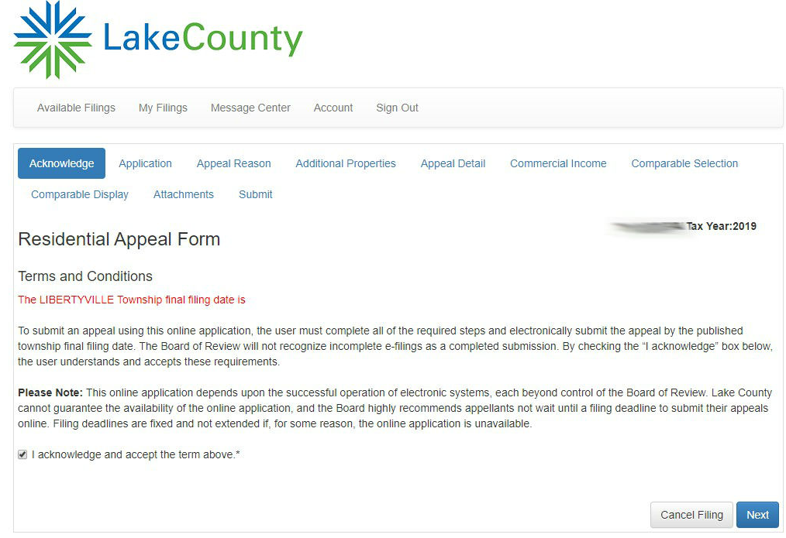
Enter Subject Property and Accept Terms
Enter your 10-digit PIN and click Start Filing
Acknowledge and accept terms and click Next
20

Slide 22
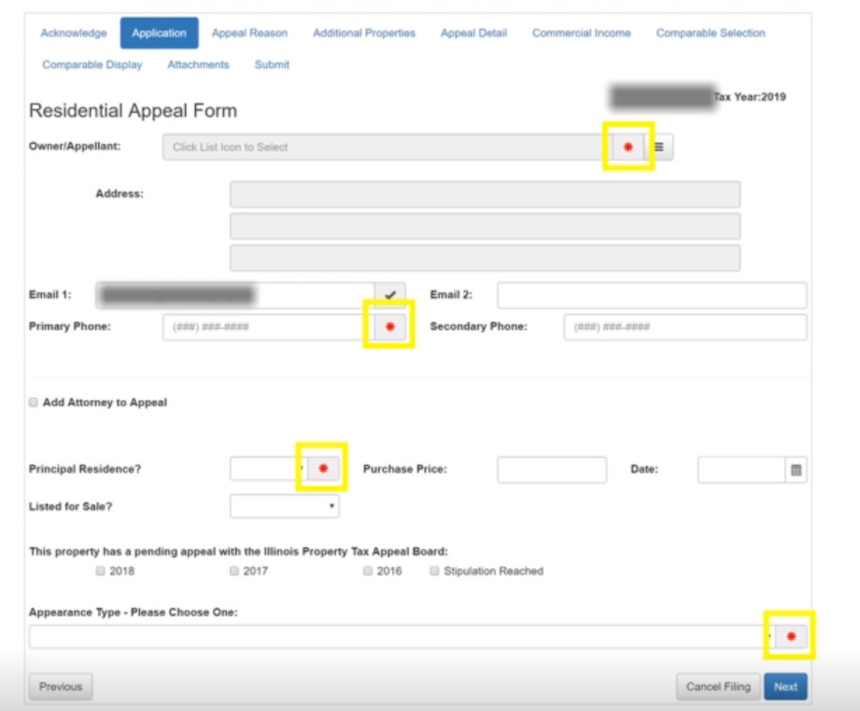
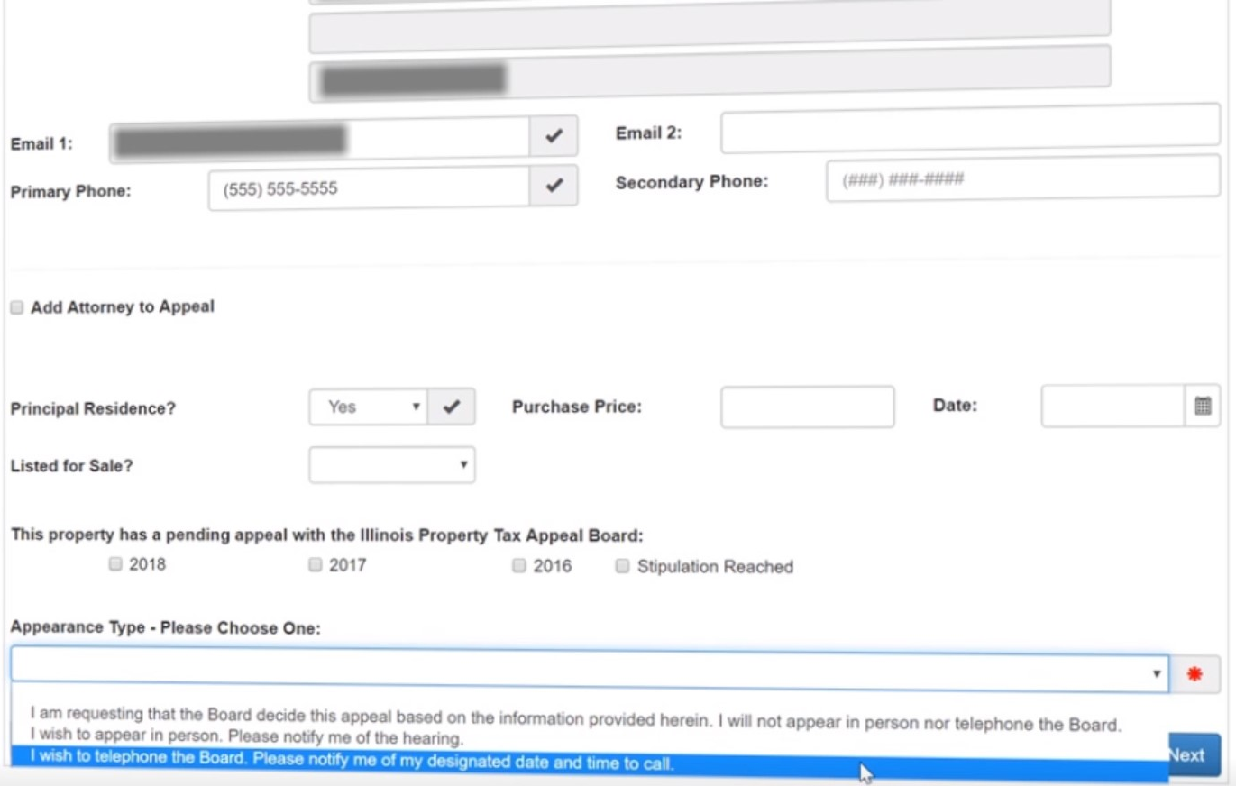
Complete Contact Form and Select Appearance Type
21

Slide 23
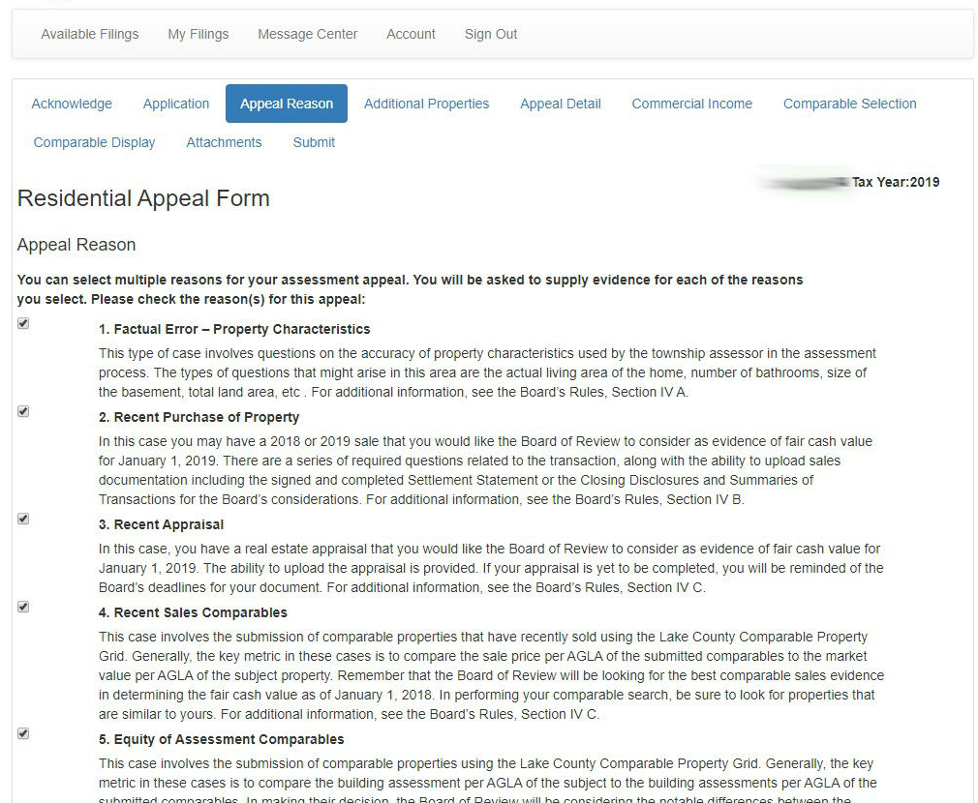
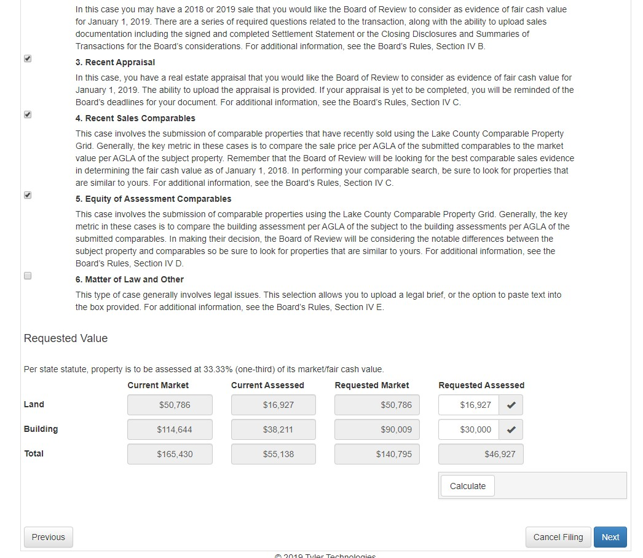
Choose Appeal Reason and Enter Requested Assessed Value
22

Slide 24
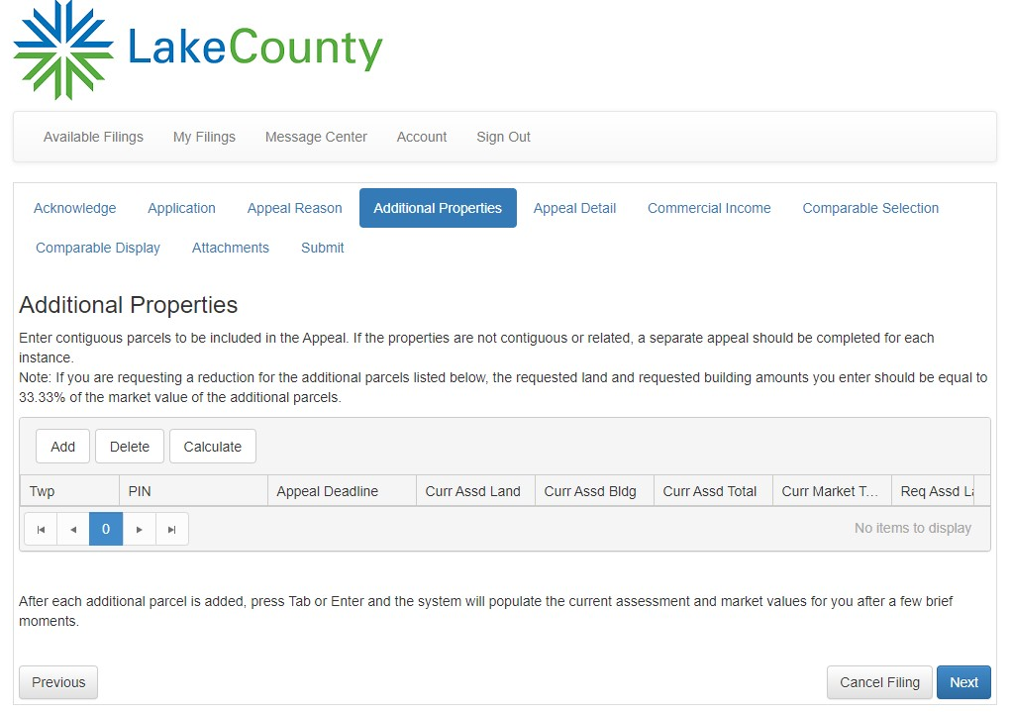
Add Additional PINS if Applicable
Otherwise click next
23

Slide 25

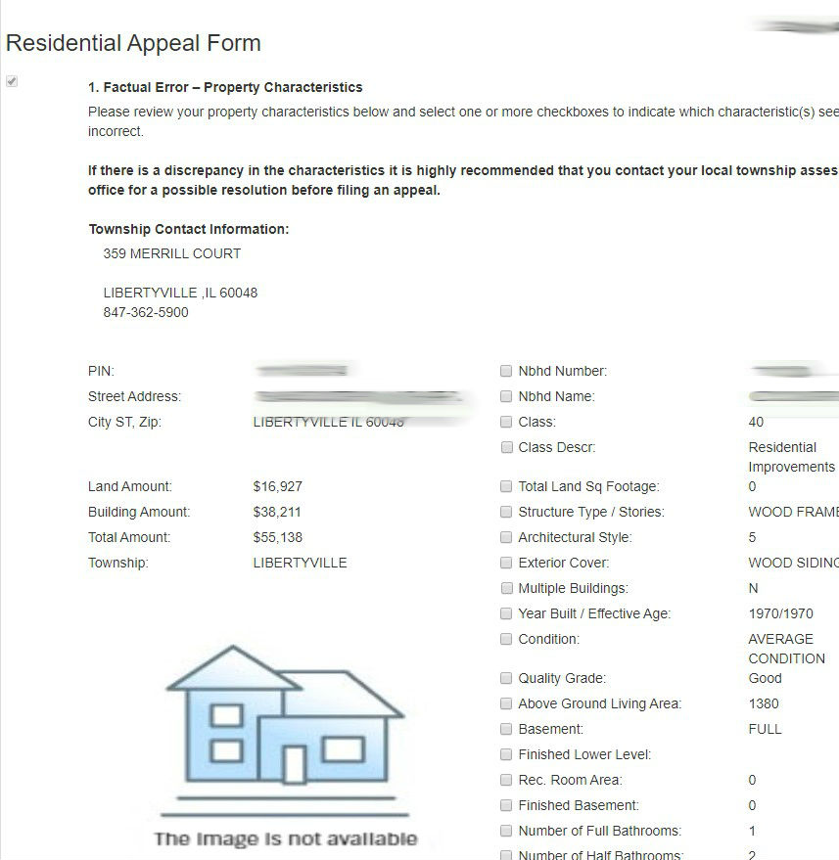
Appeal – Factual Error
Go to IMSLake.org to confirm the most current property characteristics. Call your local assessor if there are any errors.
Factual Error appeals are generally resolved in the local assessors’ office.
24

Slide 26
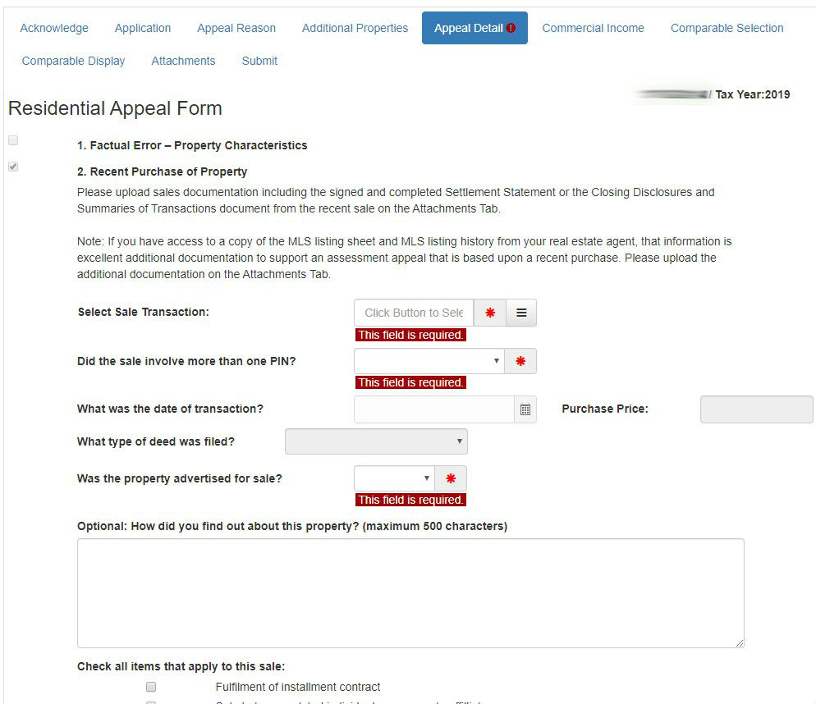
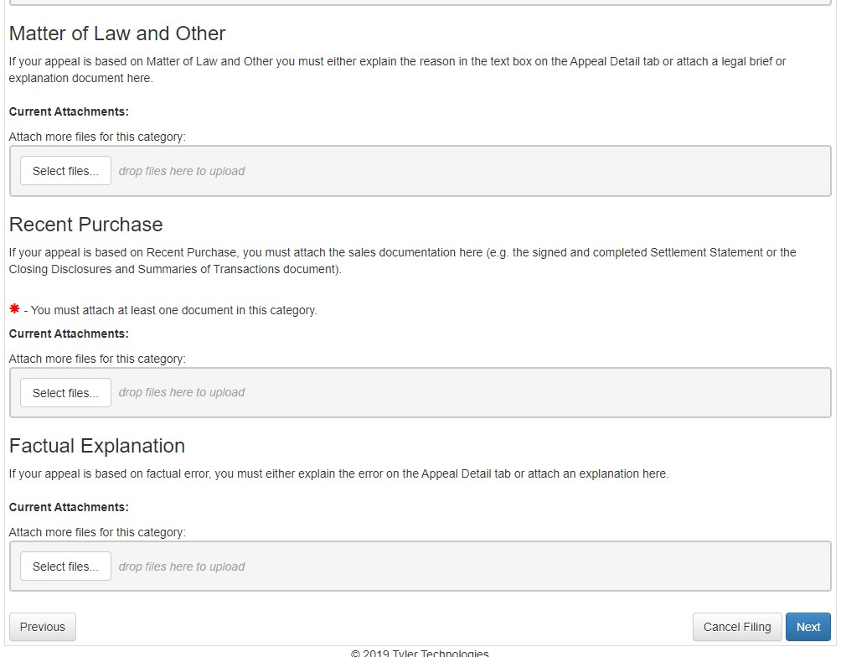
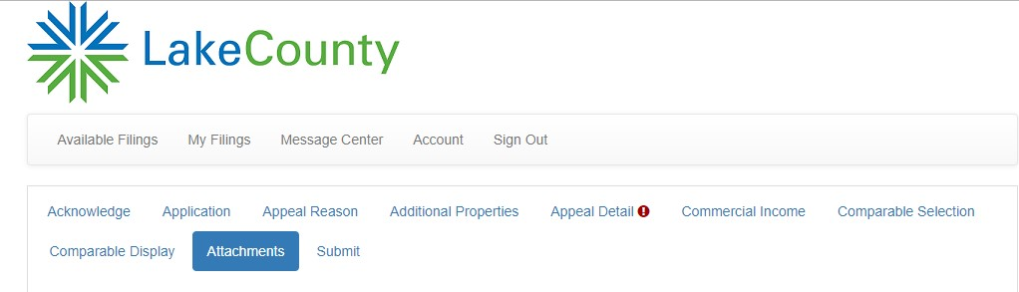
Appeal – Recent Purchase of Property
25

Slide 27
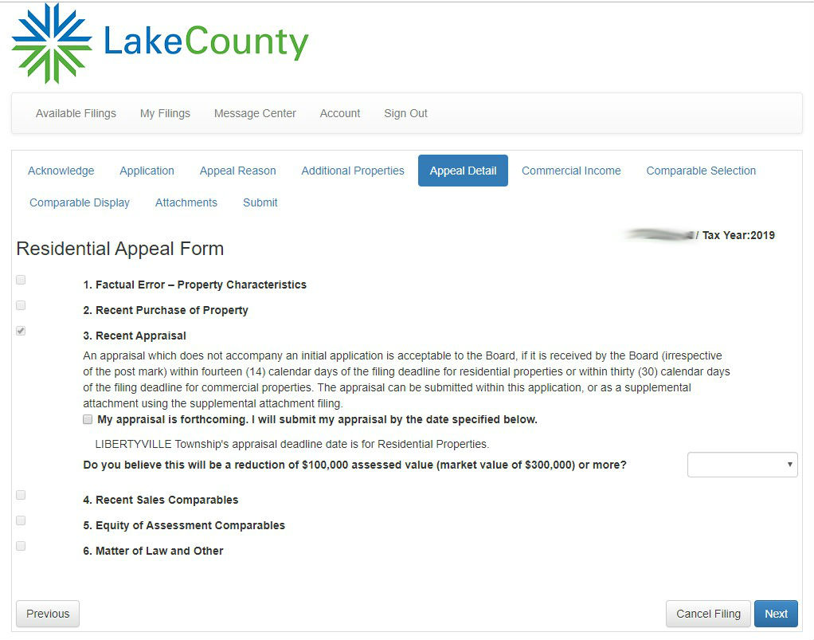
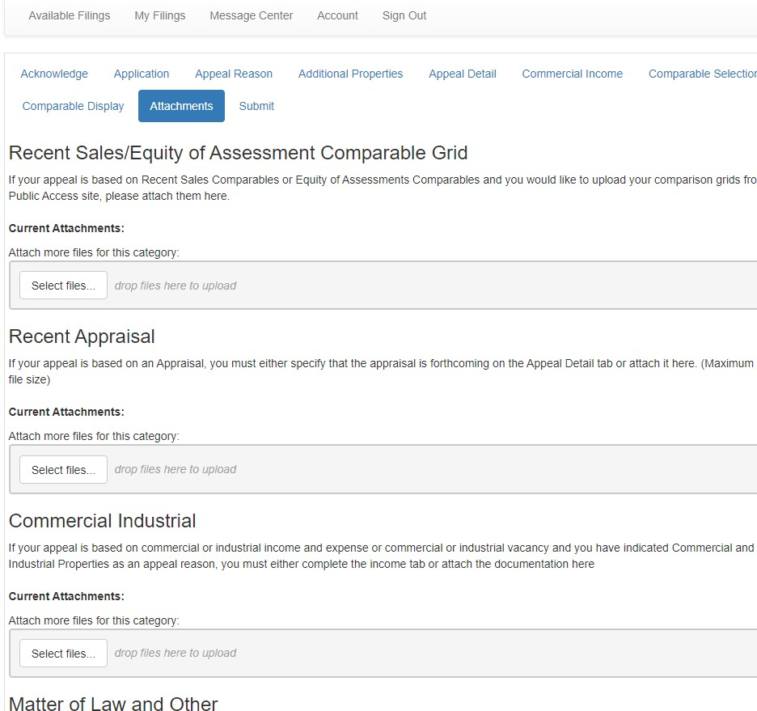
Appeal – Recent Appraisal
26

Slide 28

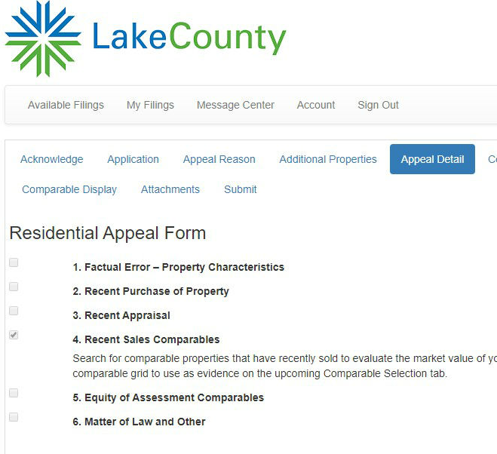
Appeal – Comparable Sales
Comparable grids for Cuba, Ela, Grant, Libertyville and Vernon Townships are available on IMSLake.org.
Earlier slides demonstrated how to create the grid and save it to your computer.
Instead of hitting “Next” proceed to the Attachments tab and upload your grid and any other evidence you may have.
27

Slide 29
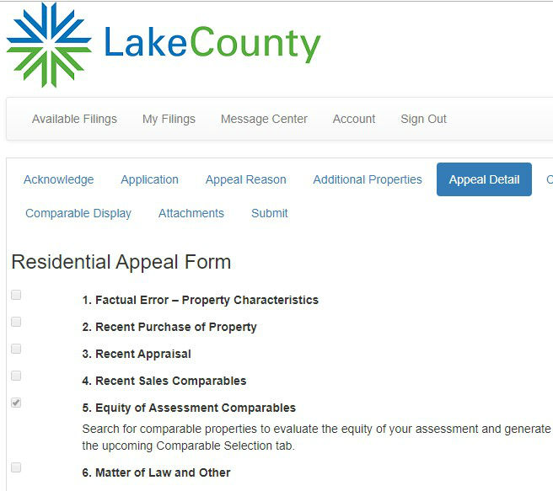
Appeal – Equity of Assessments
Comparable grids for Cuba, Ela, Grant, Libertyville and Vernon Townships are available on IMSLake.org.
Earlier slides demonstrated how to create the grid and save it to your computer.
Instead of hitting “Next” proceed to the Attachments tab and upload your grid and any other evidence you may have.
28

Slide 30
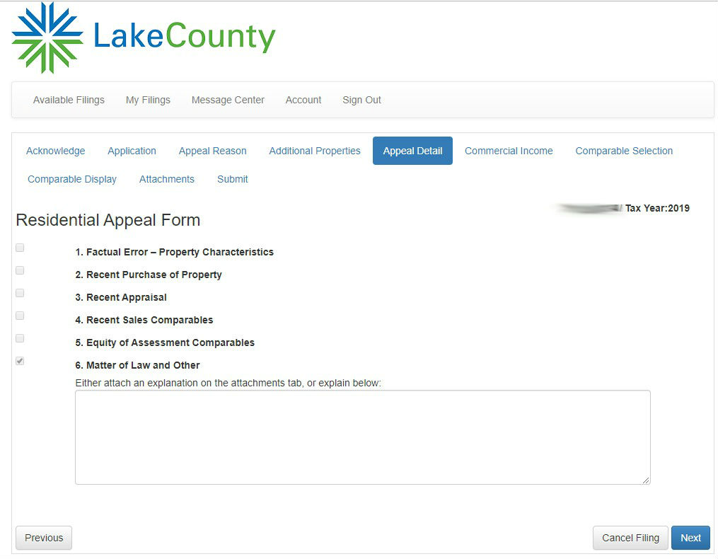
Appeal - Matters of Law
Either attach an explanation in the Attachments tab or explain your reason in the text box provided.
29

Slide 31
Call for More Information
IMS Lake County Assessor’s Offices
Cuba Township Assessor’s Office Nicole E. Knapik | 847-381-1120 info@cubaassessoril.gov
Ela Township Assessor’s Office Penelope Herr | 847-438-8370 assessor@elaassessor.org
Grant Township Assessor’s Office Lisa LaMantia | 847-546-8880 llamantia@granttwpassessor.com
Libertyville Township Assessor’s Office Christine G. Feeney | 847-362-5900 info@libertyvilleassessor.com
Vernon Township Assessor’s Office Curtis Perlman | 847-634-4602 info@vernonassessor.com
30

